Slide 1

Data Structures in Python

Slide 2

Agenda
Introduction to Range Query problems
Segment Tree concept and operations
Range updates using Lazy Propagation
Binary Indexed Tree (Fenwick Tree)
Comparison of Segment Tree and BIT
Practice examples and applications

Slide 3
Unit Overview
This unit introduces Range Query Algorithms, which are used to efficiently perform queries and updates on a range of elements in an array. Students will learn advanced data structures like Segment Tree, Lazy Propagation, and Binary Indexed Tree (BIT) that help reduce query and update time from O(n) to O(log n).
These techniques are widely used in databases, analytics systems, and competitive programming.

Slide 4
Introduction to Range Query Problems
A range query asks questions about a subarray or range of elements.
Examples:
Find sum from index L to R
Find minimum from index L to R
Find maximum from index L to R
Example:
Array: [2, 5, 1, 4, 9, 3]
Queries:
Sum(1,4) → 5+1+4+9 = 19
Min(2,5) → 1

Slide 5
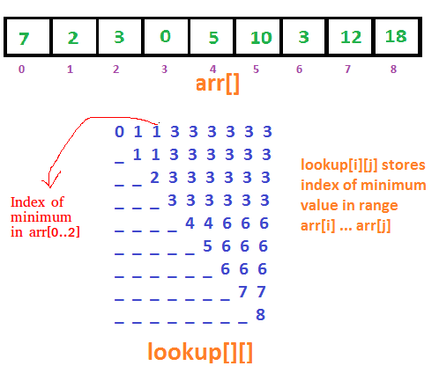
Introduction to Range Query Problems

Slide 6
Why Efficient Range Query Needed?
Normal approach:
Each query takes O(n)
For many queries → slow
Example:
n = 100000
queries = 100000
Total = 10^10 operations ❌ Slow
Efficient structures:
Segment Tree → O(log n)
Binary Indexed Tree → O(log n)

Slide 7
Segment Tree
A Segment Tree is a tree data structure used to store range information.
It allows:
Fast range queries → O(log n)
Fast updates → O(log n)
Structure Example
Array:
[2, 5, 1, 4]
Tree representation:
12
/ \
7 5
/ \ / \
2 5 1 4
Each node stores sum of children.

Slide 8
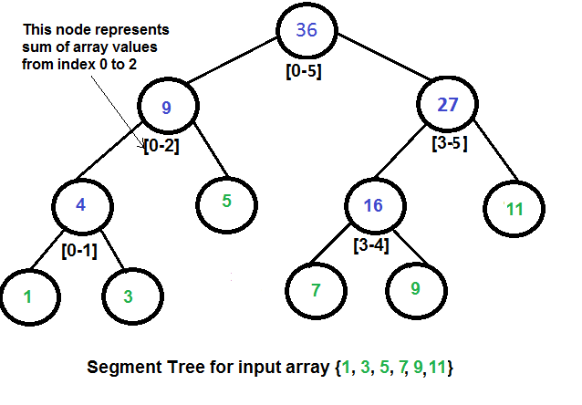
Segment Tree

Slide 9
Segment Tree
Operations
1. Build Tree → O(n)
2. Range Query → O(log n)
3. Update → O(log n)

Slide 10
Lazy Propagation
Problem Without Lazy Propagation
If updating range:
Update(1,4,+5)
Normal Segment Tree updates each element → slow
Time complexity: O(n)
Solution: Lazy Propagation
Lazy propagation delays updates until needed.
Instead of updating immediately, store update in lazy array.

Slide 11
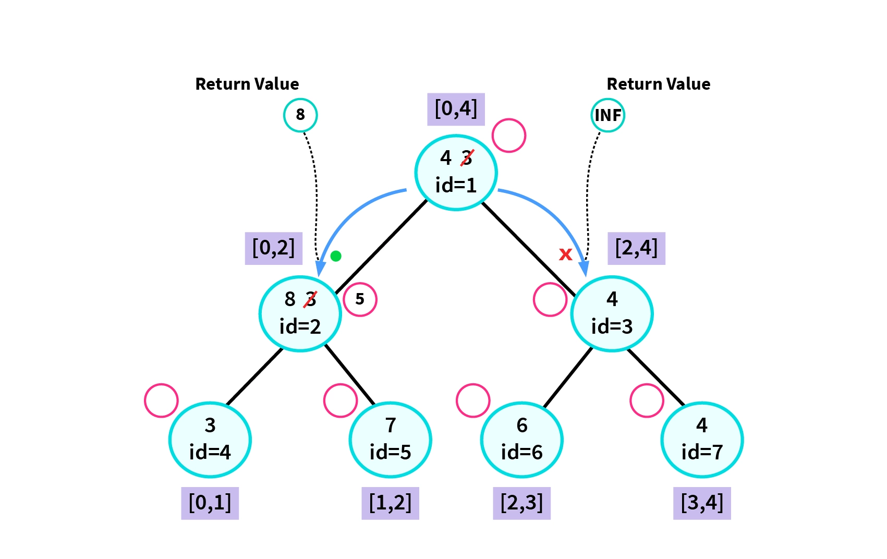
Lazy Propagation

Slide 12
Lazy Propagation
Benefits
Fast range update → O(log n)
Fast range query → O(log n)
Lazy Array Concept
lazy[node] stores pending update
Apply update only when needed.
Lazy stores update without updating all nodes immediately.
Example Concept
Array:
[1,2,3,4,5]
Update:
Add +10 to range (1,3)

Slide 13
Binary Indexed Tree (BIT) / Fenwick Tree
Binary Indexed Tree is used for:
Prefix sum queries
Fast updates
Time Complexity:
Update → O(log n)
Query → O(log n)

Slide 14
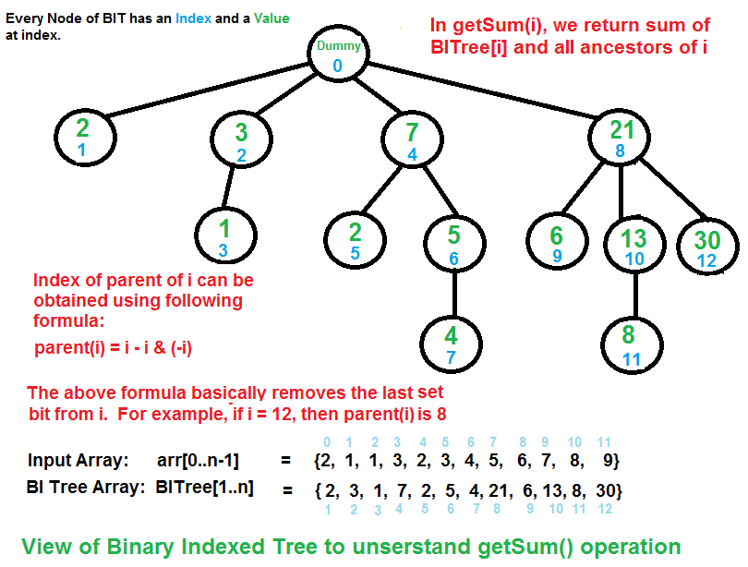
Binary Indexed Tree (BIT) / Fenwick Tree

Slide 15
Binary Indexed Tree (BIT) / Fenwick Tree
Structure Concept
Array:
[2,5,1,4]
BIT stores partial sums.
Visualization
BIT array example:
Index: 1 2 3 4
Value: 2 7 1 12
Operations
Update
Add value at index
Query
Find prefix sum

Slide 16
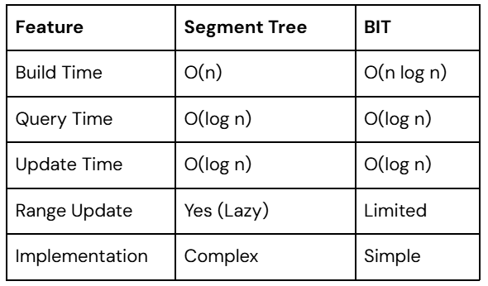
Segment Tree vs BIT Comparison

Slide 17
Applications
Segment Tree Applications:
Range sum query
Range minimum query
Range maximum query
Game development
Competitive programming
BIT Applications:
Prefix sums
Frequency counting
Inversion count

Slide 18
Real-World Applications
Database systems
Financial analysis
Analytics systems
Competitive programming
Range statistics computation

Slide 19
Key Outcomes
Understand range query problems
Implement Segment Tree for range queries
Apply Lazy Propagation for efficient updates
Implement Binary Indexed Tree (BIT)
Perform fast range query and update operations
Apply range query algorithms in real-world problems

Slide 20
Thank You!

